Slide 1
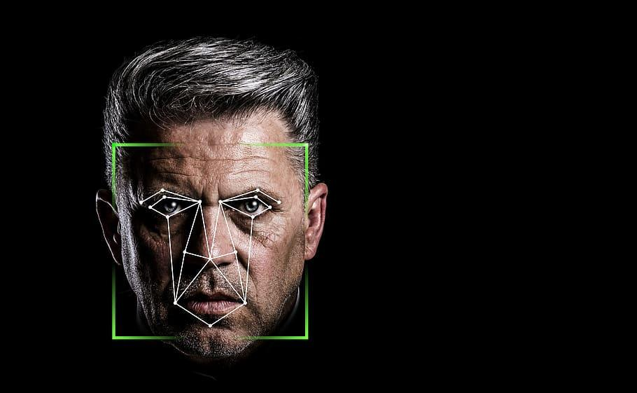
Facial Keypoint Recognition
Initial Modelling
w207 03, Spring 2021
The Black Boxes

Slide 2
Modelling Overview
Data explored, cleaned.
3 datasets to model:
Raw dataset - use mean to fill missing values
Duplicates removed - use mean to fill in missing values
Augmented dataset - Linear regression to predict missing values
This is a regression problem i.e. trained model predicts the x, y values of the keypoints given an image
Models tried:
Linear regression: OLS, ridge, lasso
Decision tree regression
K-nearest neighbors regression (use 5 and 7 neighbors).

Slide 3
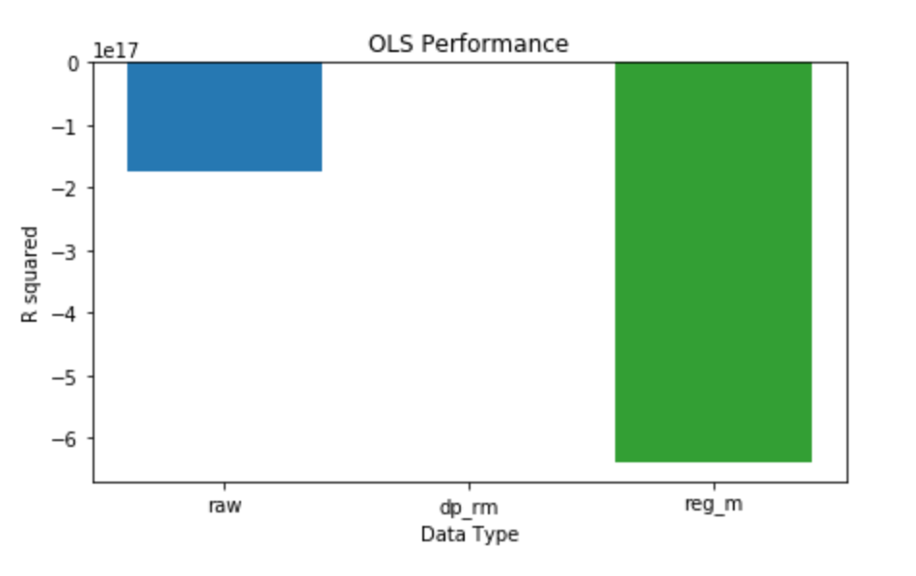
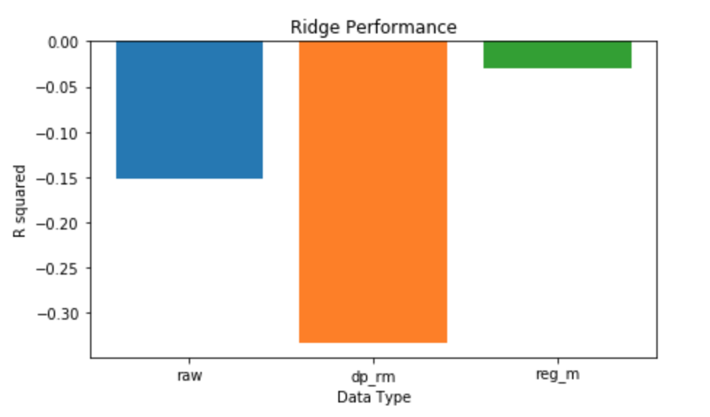
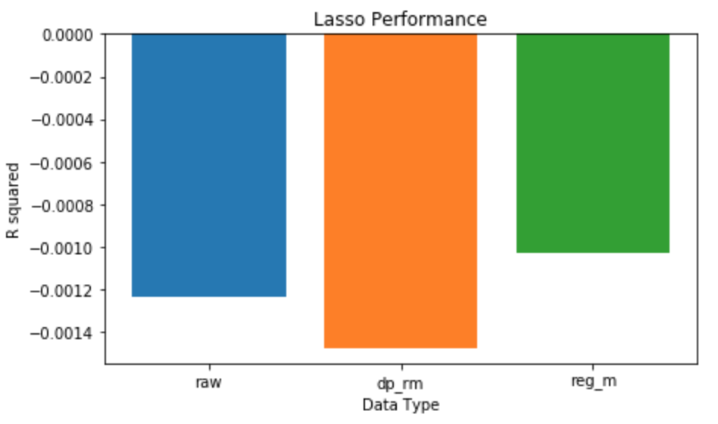
Linear Model Performance

Slide 4
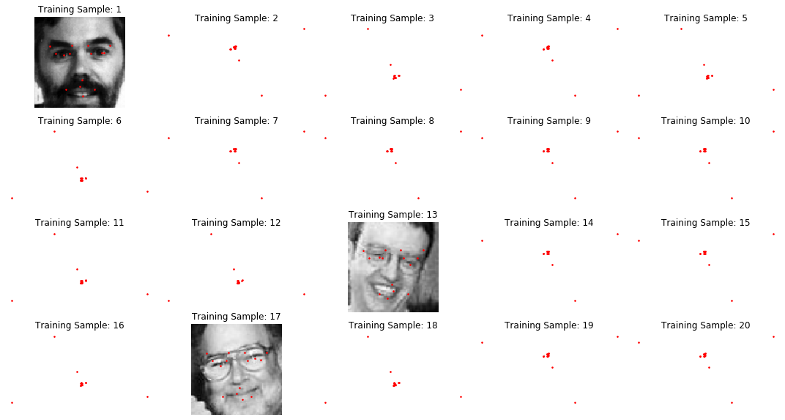
Examples: OLS Predictions

Slide 5
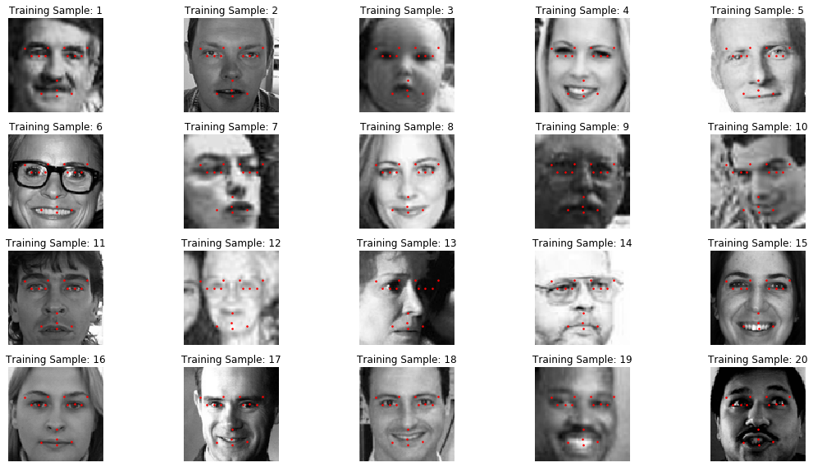
Examples: Lasso Predictions

Slide 6
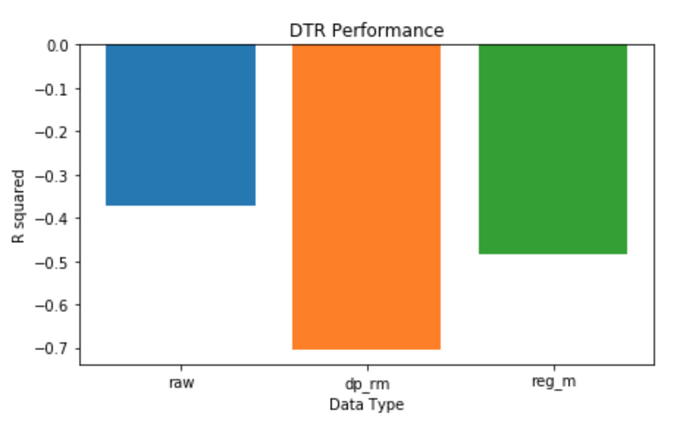
Decision Tree Regression Performance

Slide 7
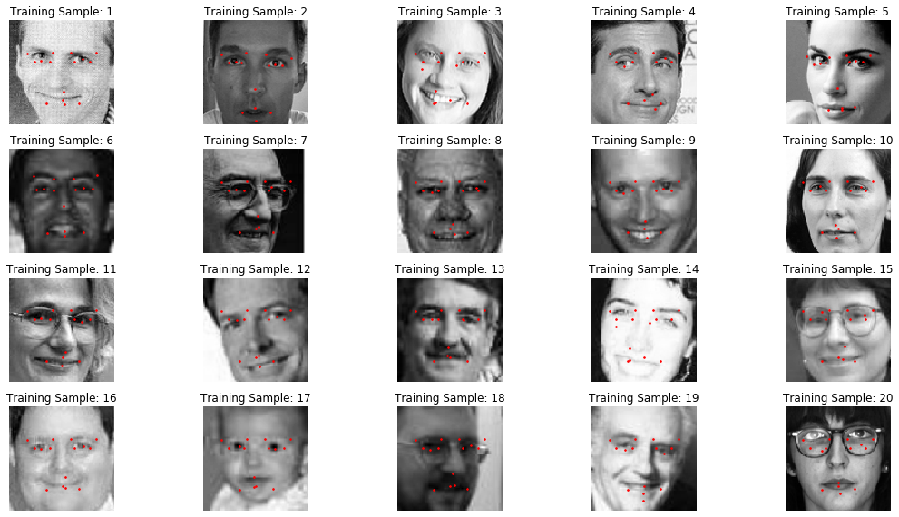
Examples: Decision Tree Predictions (raw dataset)

Slide 8
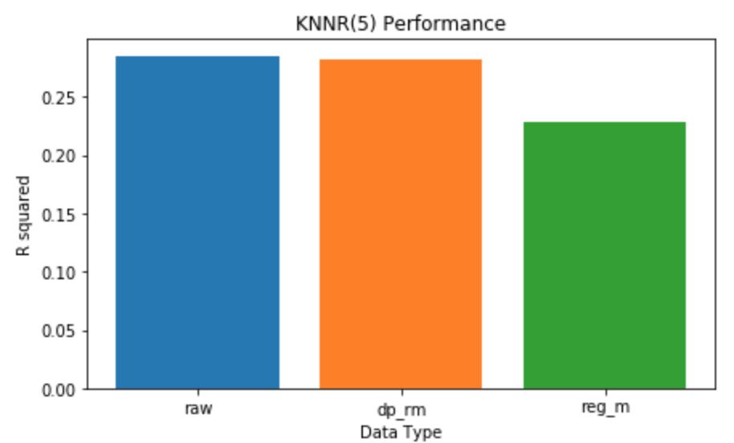
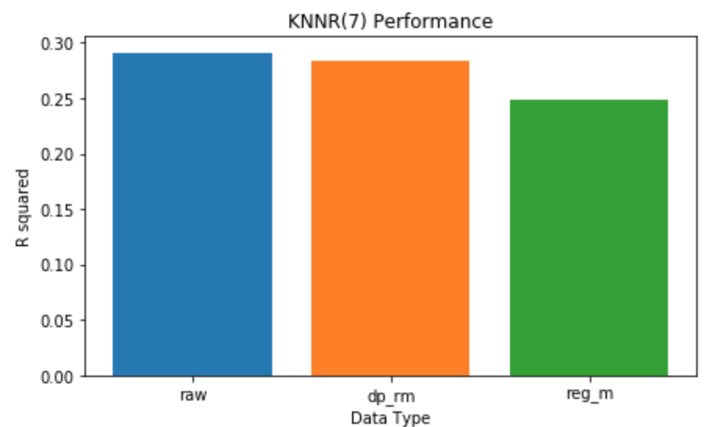
K-Nearest Neighbors Regression Performance

Slide 9
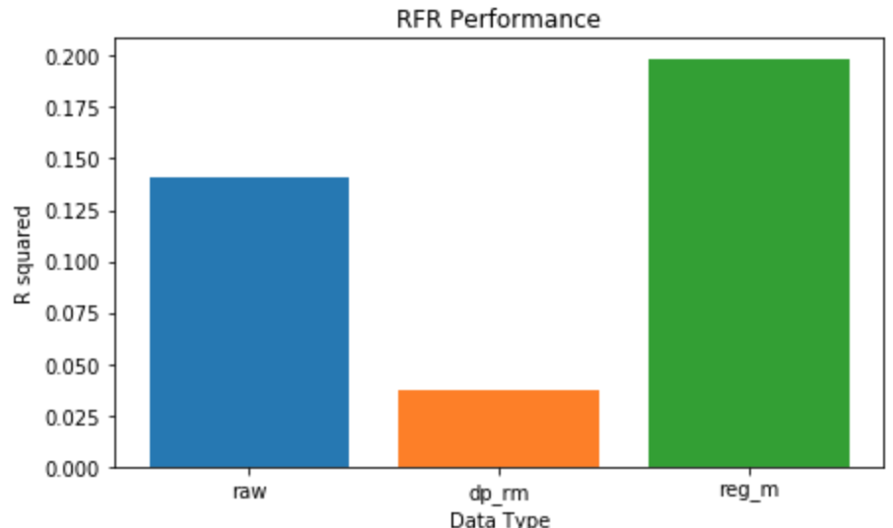
Random Forest Regression (5 estimators)

Slide 10
Summary of Modelling
Standard SKL regression models do not offer very good performance for this task.
KNN/RFR seem to offer the best performance out of all tested.
The raw dataset (with mean fill) generally gives best performance.
Eyeglasses, angled and childrens faces seem to pose challenges.
Computationally intensive - take long time to run, difficult to optimize.
The impact of various data processing methods is variable and model dependent.

Slide 11
Next Steps
Look into deep learning frameworks - TensorFlow, PyTorch etc.
See if any standard models (non-DL) can be optimized for this task e.g. ensemble methods.

